Slide 1
PLACEMENT SKILLS ASSESSMENT SYSTEM AND BENCHMARKING

Slide 2
Students:
Arpana.S 711715205002 (IV B.Tech IT)
Himanshu Jain.P 711715205008 (IV B.Tech IT)
Vallikannu.A.R 711715205033 (IV B.Tech IT)
Project Guide:
Dr.G Vijaya,Head of the Department,Information Technology

Slide 3
Problem Statement
Online MCQs are capable in providing scores based upon answers provided but are not capable to analyse the actual performance and improvement of a Student.

Slide 4
Abstract
This project is built to enhance and assess the students and train them for their placements. The system provides the student with an initial test that is called a mandatory test to all students at all disciplines during their beginner stage. Then based upon the outcome, the system will generate an individual student report, where each and every student data will be analyzed by the system and their benchmarks will be highlighted. Furthermore, tests will be generated based upon their previous performance and test questions will be randomly distributed for each students based upon their weakness. The student can attempt the test multiple times to improve his/ her placement related skills. The attempts made by the students and scores related to it will be updated to the respective faculty members of the particular department and even to students who will receive a copy of the same.
Keywords: Placement, Assess student, Analyse

Slide 5
Literature Survey
Placement Test Web Portal
Author name:Anand Singh[1],Aishwary Shukla[2],Maulik Sharma[3],Rahul Yadav[4
Published On:2017
In this paper specifies automation of manual procedures such as conduction of tests, displaying results, and notifying the results to students via email. They focus on the automation of placement related tests conducted by the placement cell of an Institute.
College Placement Portal
Author name:Swapnil Gholap
Published On:2017
In this paper it collects all student data and provides it to admin(Placement officer). The admin then processes this data to identify eligible students. Also, their system conducts regular tests to check the eligibility of students. Based upon their scores, eligibility is defined.

Slide 6
Literature Survey(Contd)
Training and Placement Web Portal:
Author name:Mr.Hitesh K Kasture
Published On:2014
In this paper it also deals with automating the placement related test process by automating it. They concentrate on bringing accuracy to the test result. Their idea is to reduce paperwork and storage space and provide user-friendly interface.

Slide 7
Modules
Student Modules
Register
Login Module
Student Dashboard
Report
View result

Slide 8
Faculty Modules
Register
Login Module
Dashboard
Upload question
View report

Slide 9
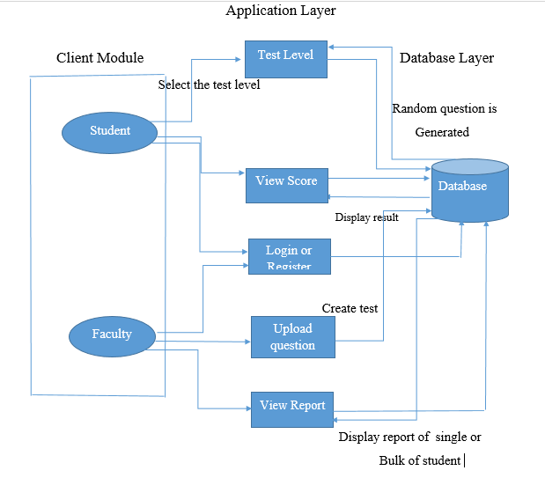
Architecture Diagram

Slide 10
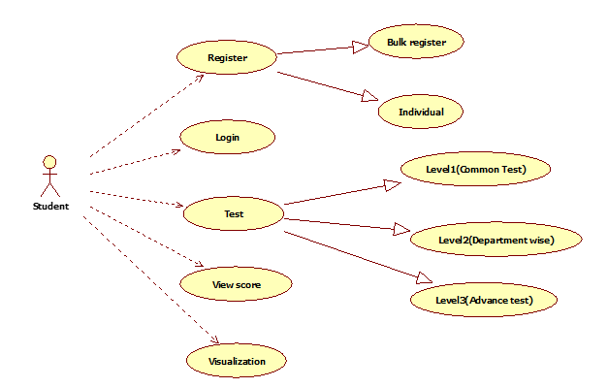
Usecase Diagram
Student:

Slide 11
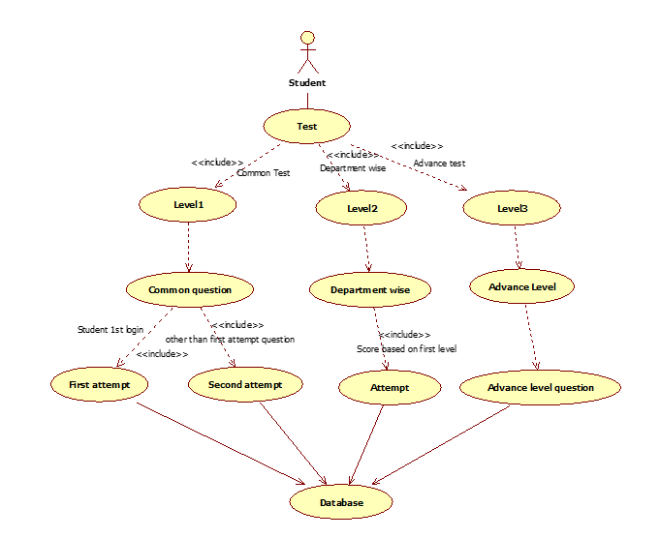
Randomization

Slide 12
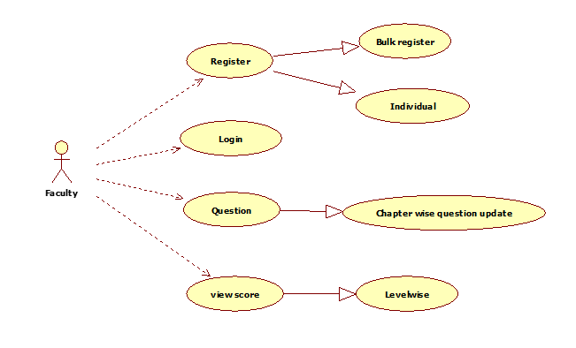
Faculty Module

Slide 13
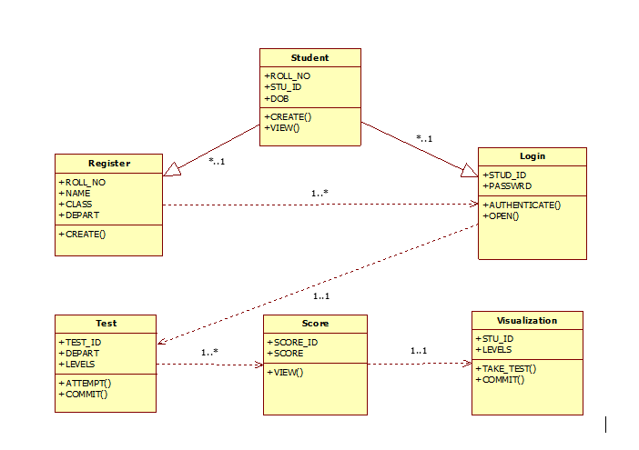
Class Diagram
Student:

Slide 14
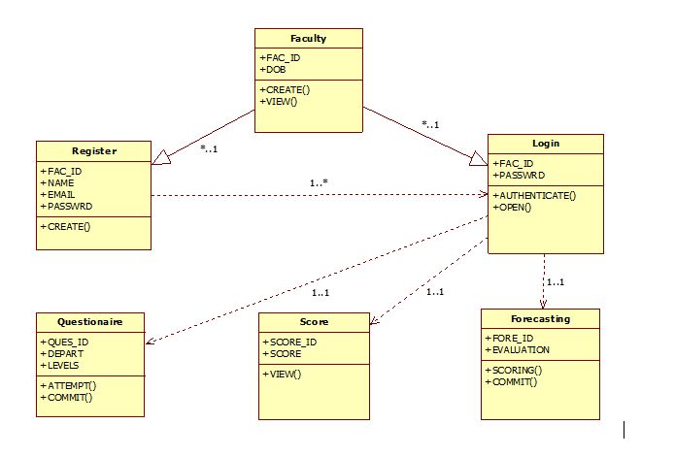
Class Diagram(contd)
Faculty:

Slide 15
ER Diagram
Student Module
Faculty Module

Slide 16
Requirement analysis for each module
Student Module:
Register
Login
Level wise test
Attempt the test
View Result
Logout

Slide 17
Contd..
Faculty Module:
Register
Login
Question update
View Report
Create test session
Display result
Logout

Slide 18
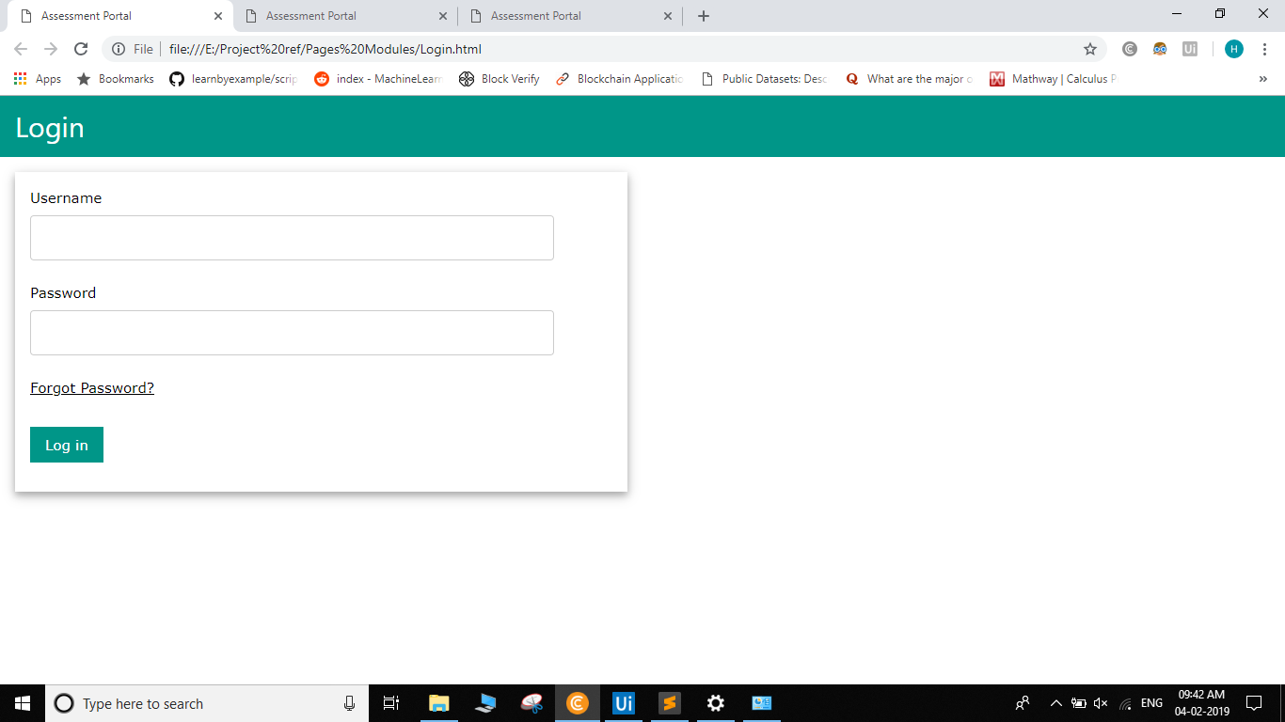
User Interface (Login)

Slide 19
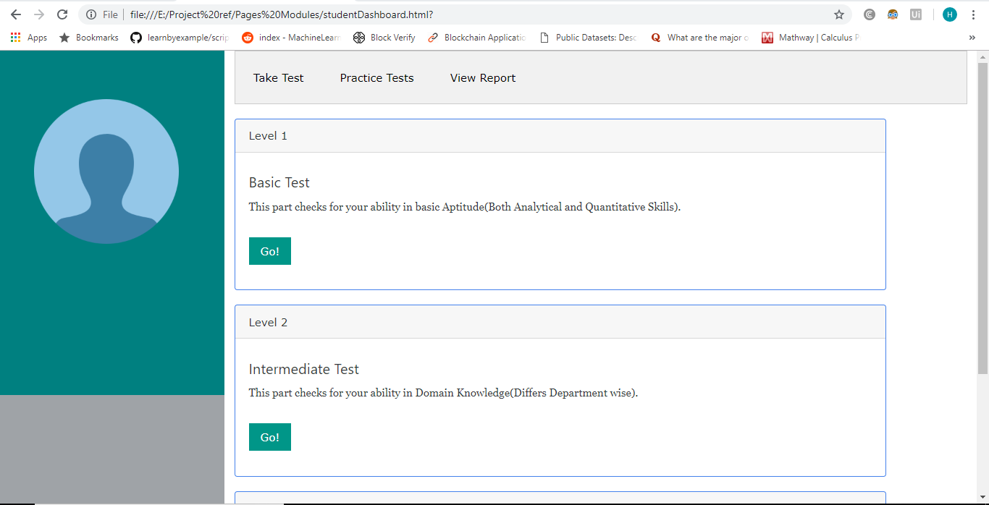
Student Module(Dashboard)

Slide 20
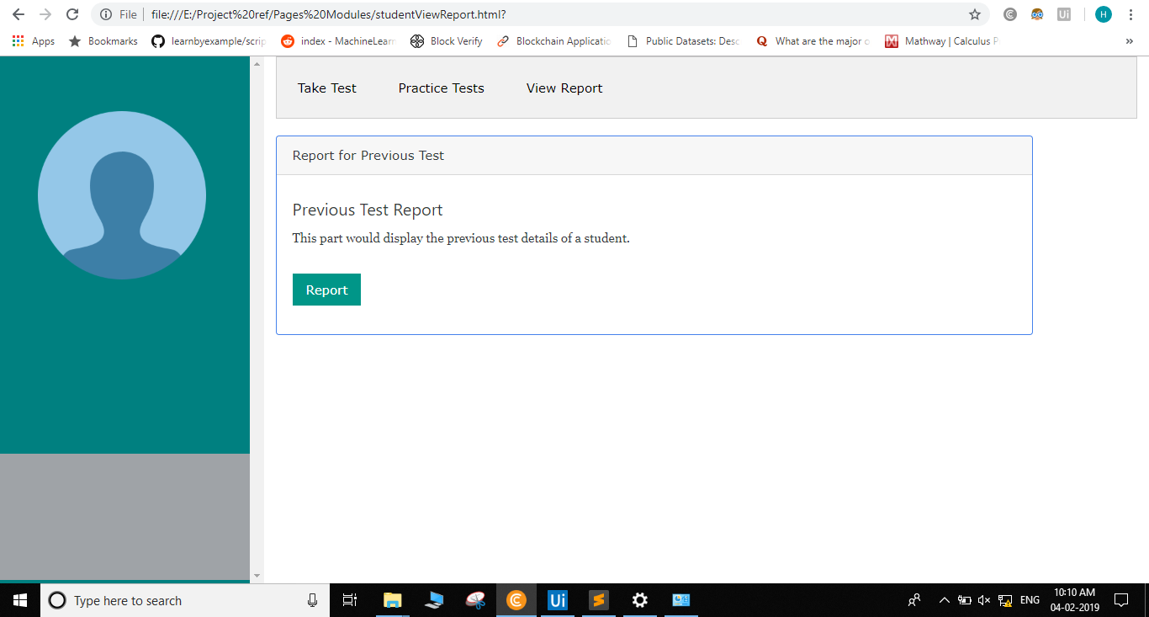
Student report

Slide 21
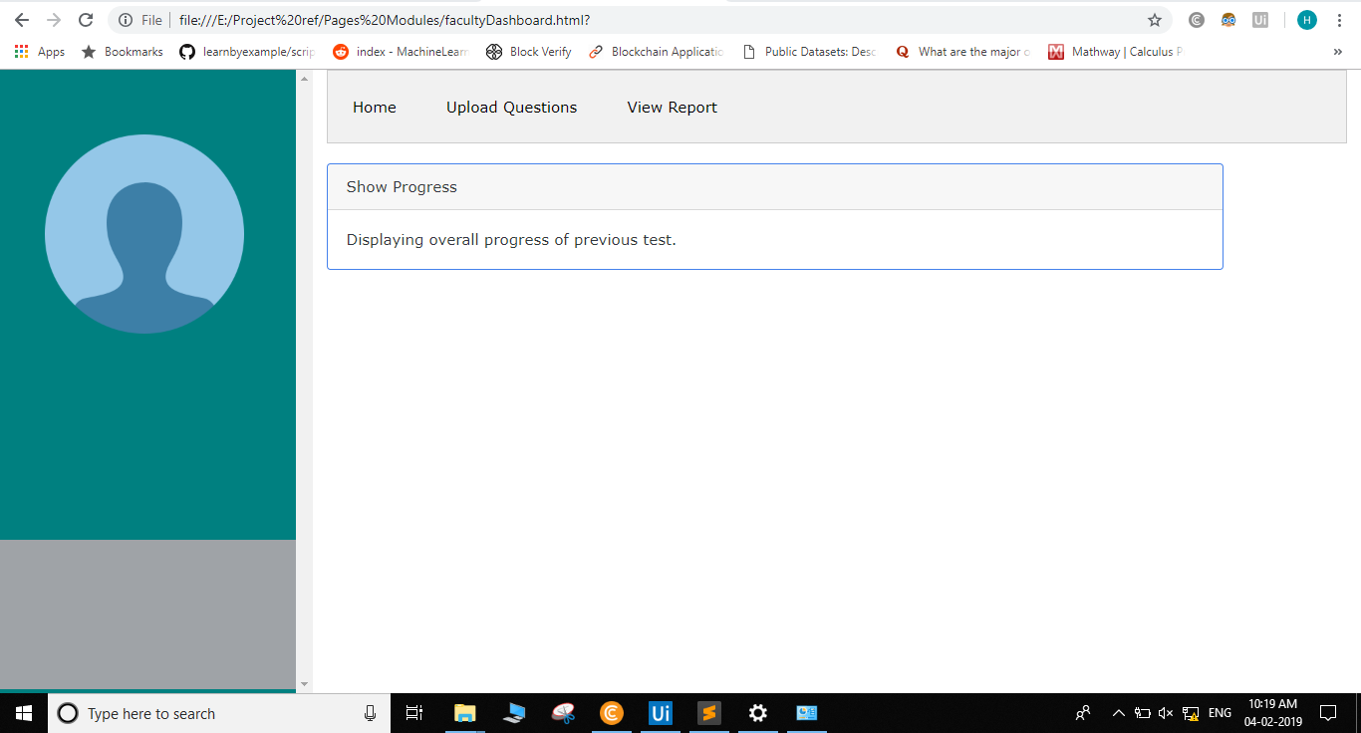
Faculty Dashboard

Slide 22
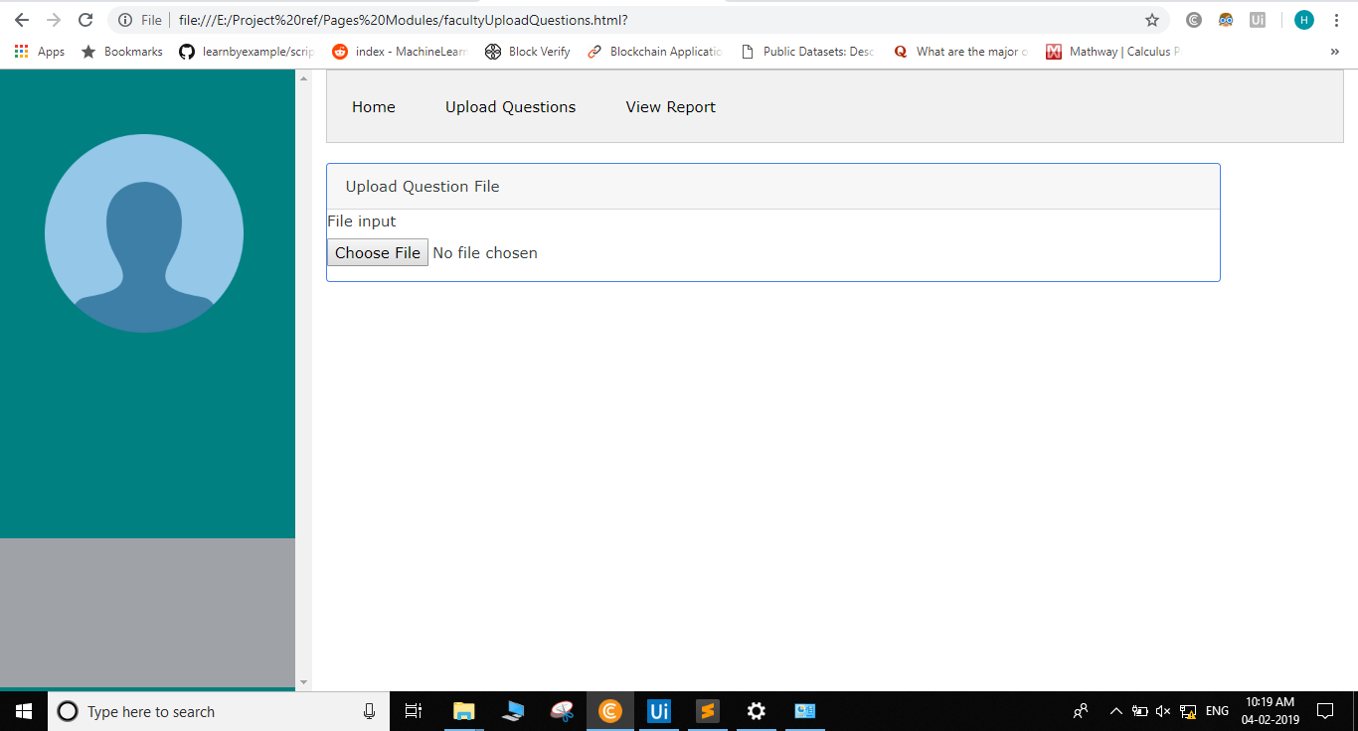
Faculty(Upload question)

Slide 23
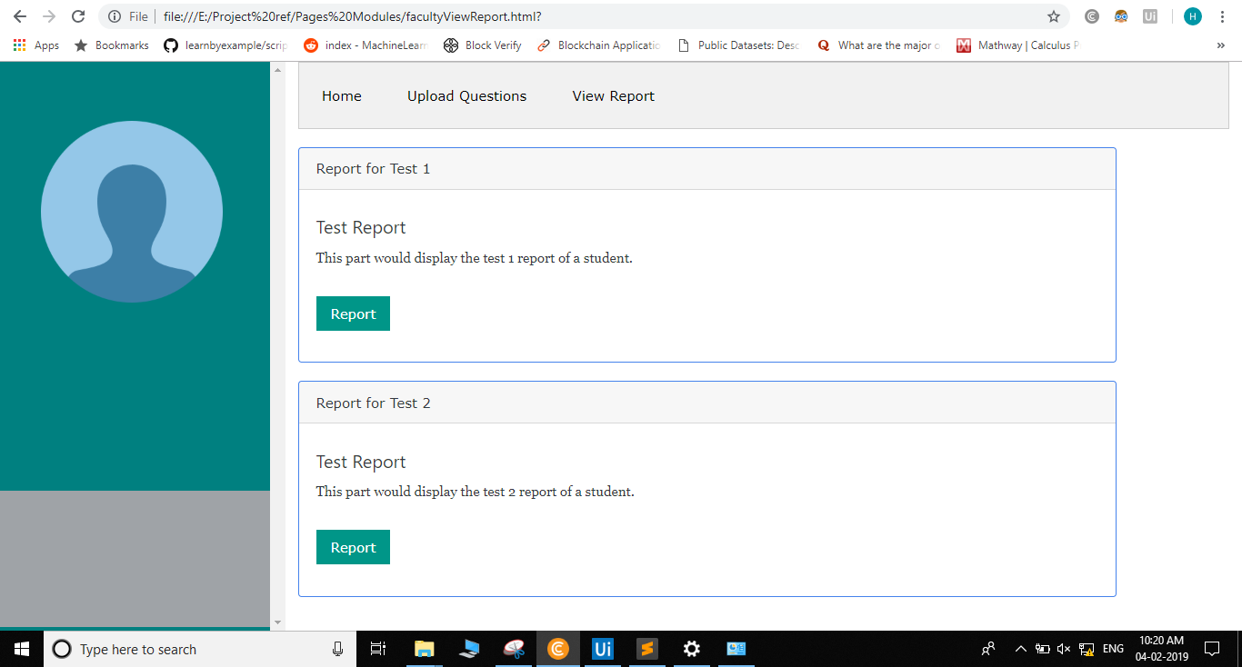
Faculty(View Report)

Slide 24
Conclusion
This application concentrates on analysing individual student based upon their MCQ scores and set a difficulty level for them. As the student improves, the difficulty level increases to enhance their ability. When a Student re-enters the test session and takes multiple attempts for a single test, higher number of questions based upon earlier attempt mistakes are generated to test the Student. Score in each attempt determines the level of a Student. Also, each question is extracted in a randomized way to avoid plagiarism practices during the test cycle.

Slide 25
Questions?

Slide 26
ThankYou

